Slide 1
Campaign for the Prevention of Accidents in Japanese Waters for Passing through a Narrow Channel or Traffic Congested Waters (since April 1st, 2008)
On 5th March 2008, a very serious accident occurred in Akashi Kaikyo where three vessels collided, resulting in one sunken ship, three dead Philippine crewmen and one missing.
There is a high collision risk in Akashi Kaikyo which is a strategic point of maritime transportation system as well as one of Japan’s busiest area of inland sea with fast tidal current and more than 800 vessels passing in a day, because of linking major cities in western Japan with the Pacific Ocean.
For navigational safety to pass through such a narrow channel or seaborne traffic congested area as Akashi Kaikyo in Japanese waters, please check the following items in order to prevent the serious accident by collision mentioned above.
□Is your lookout properly directed to
know what to look and listen for ?
□Does the captain command all the time
on the bridge?
□Can you change over from Autopilot to
manual steering immediately?
□Do you always pay attention to the
information of Navtex and VHF radio?
□Do you keep a careful watch on VHF
CH16 to obtain necessary information on
safe navigation?
□Are you aware of Navigation Rule of
Akashi Kaikyo?
□Do you secure all the information which
receive from your local agents?
□Do you check the information
transmitted by AIS, not only
from some other ships but also
from your ship?
Created by ：
Kobe District Transport Bureau, Ministry of Land, Infrastructure, Transport and Tourism
Feb．202４

Slide 2
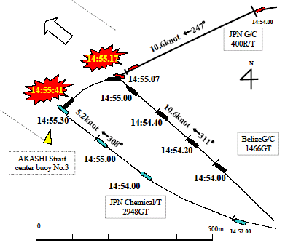
5Mar．2008
Double Collision at AKASHI Kaikyo
N
KOBE
JPN G/C 400R/T
①First Collision
RED VS BLACK
×
BelizeG/C 1466GT
×
JPN Chemical/T 2948GT
AKASHI Kaikyo
center buoy No.3
②Second Collision
BLACK VS BLUE
BLUE capsized !!
BelizeG/C 1466GT
JPN Chemical/T 2948GT
AWAJI Isl.

